Slide 1

DIY Tool Exchange
Chris Patterson

Slide 2



Storyboards
Sue Newbie - Register
All Users - Login
Ted Middleman – Search and Borrow
Bob d’Builder – Share tool
All Users – Account Info
Freddy Feedback – Rating (Stretch Feature)

Slide 3

Register
Persona: Sue Newbie

Slide 4

As a brand-new user, Sue Newbie needs to register in order to use the site.

Slide 5
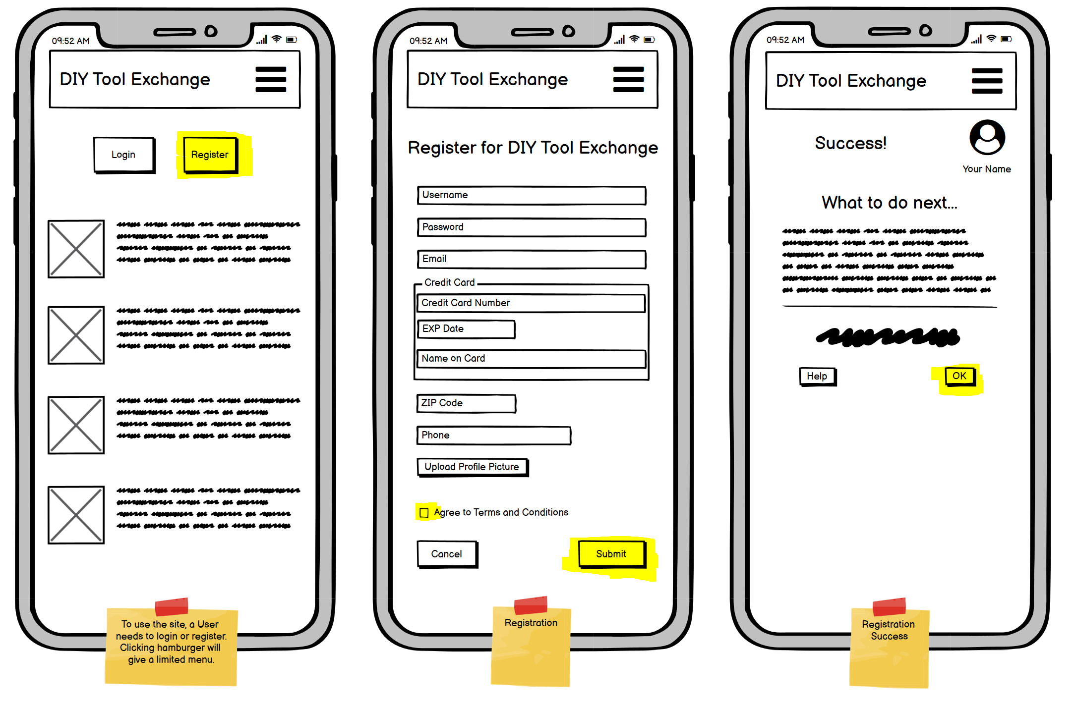
Registration Steps
Sue is presented with the screen for users who are not logged in. She selects “Register”.
One the next screen, Sue is presented with a registration form. The fields in red are required.
She must accept TAC, and then submit the form.
On success, Sue will be notified. By clicking OK, she is taken to her dashboard.

Slide 6
Log In
Persona: All Users

Slide 7
All users must log in before being allowed to use the site.

Slide 8
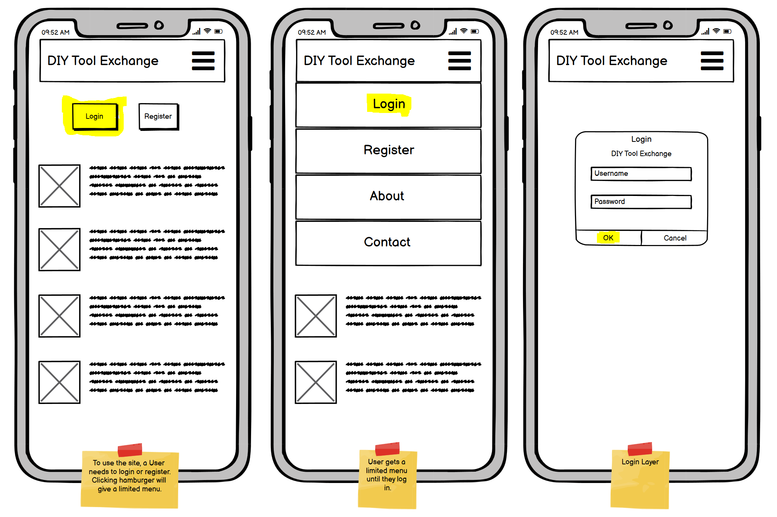
Log In Steps, From Home Screen
User is presented with a Log In button. If they click that button, they are taken to the login screen.
Or, If they try to click the hamburger, they are presented with a limited menu pointing to login as well.
Once logged in, the user is presented with their dashboard page.

Slide 9
Search & Borrow
Persona: Ted Middleman

Slide 10
Ted Middleman Searches for a tool, finds what he needs, and borrows it.

Slide 11
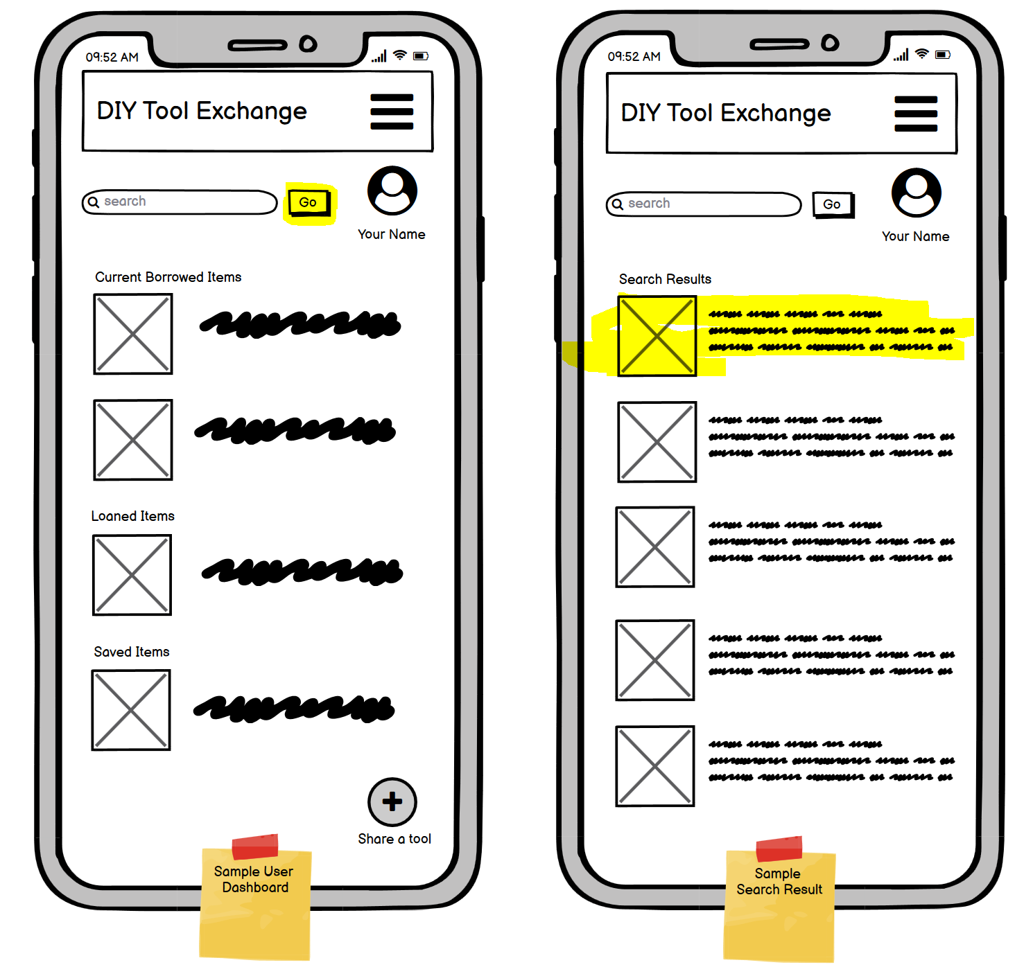
Searching, Part 1
From his dashboard, Ted enters a search term for a tool he needs.
He selects Go.
He is presented with a results page.
He selects a tool that looks like the one he needs . . .

Slide 12
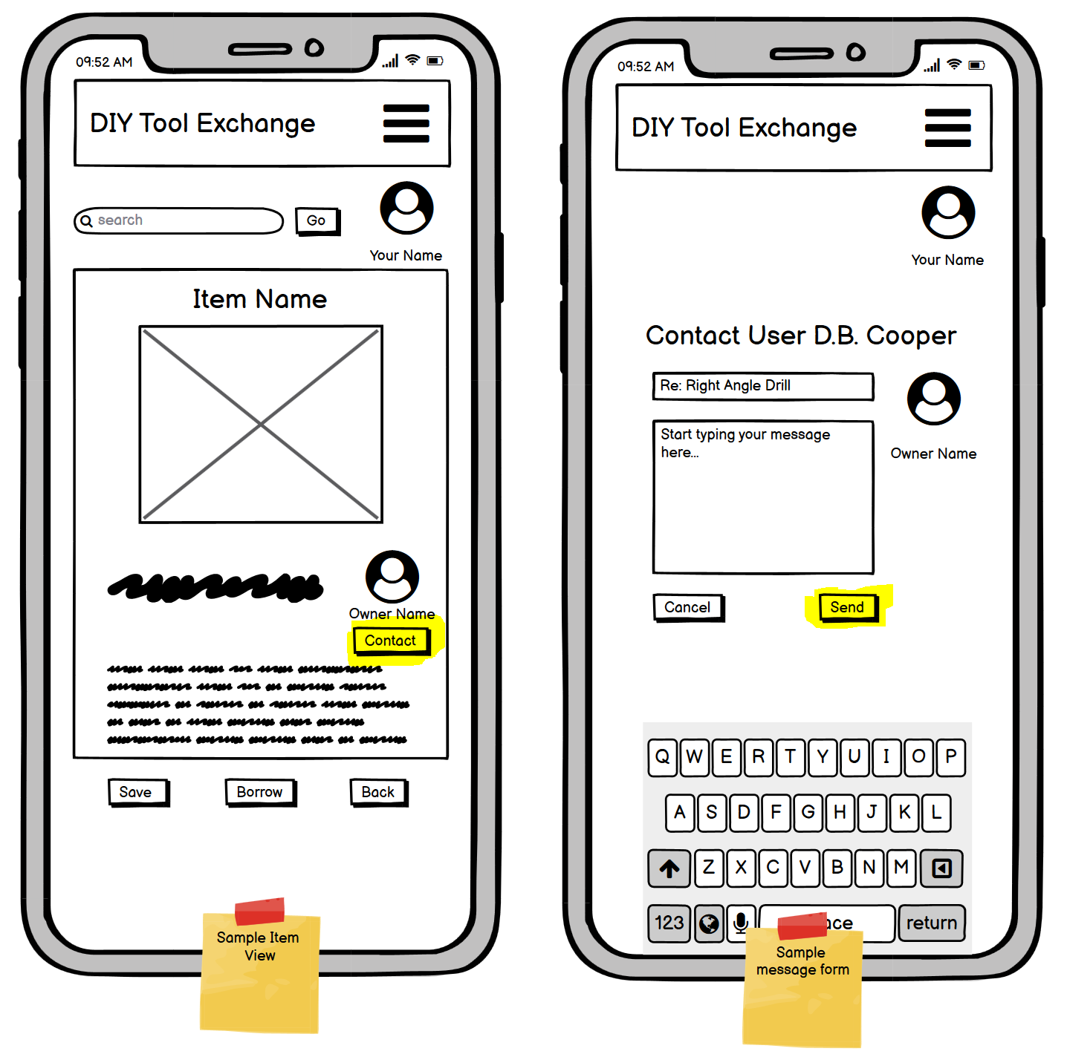
Searching, Part 2
Ted is taken to the items page.
He has questions about the tool, so he contacts the owner by selecting Contact
He is presented with a contact page.
He fills in the contact form and selects Send.

Slide 13
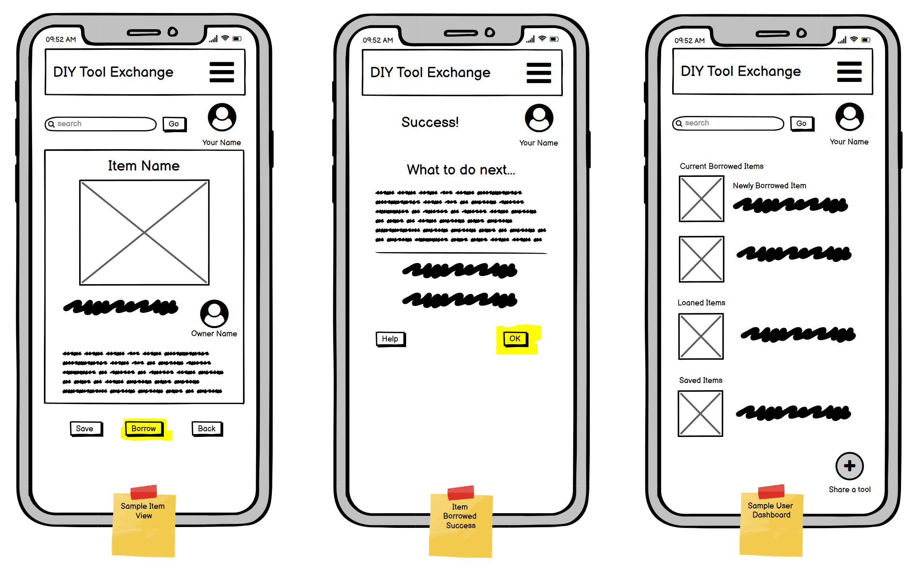
Borrowing
After a search, Ted is taken to the items page.
He decides this is the tool he needs to borrow. He selects Borrow.
He is presented with a success page which provides exchange instructions.
He selects OK and is taken back to his dashboard.

Slide 14
Sharing
Persona: Bob D’Builder

Slide 15
Bob D’Builder has an older tool he wants to share and list for sale.

Slide 16
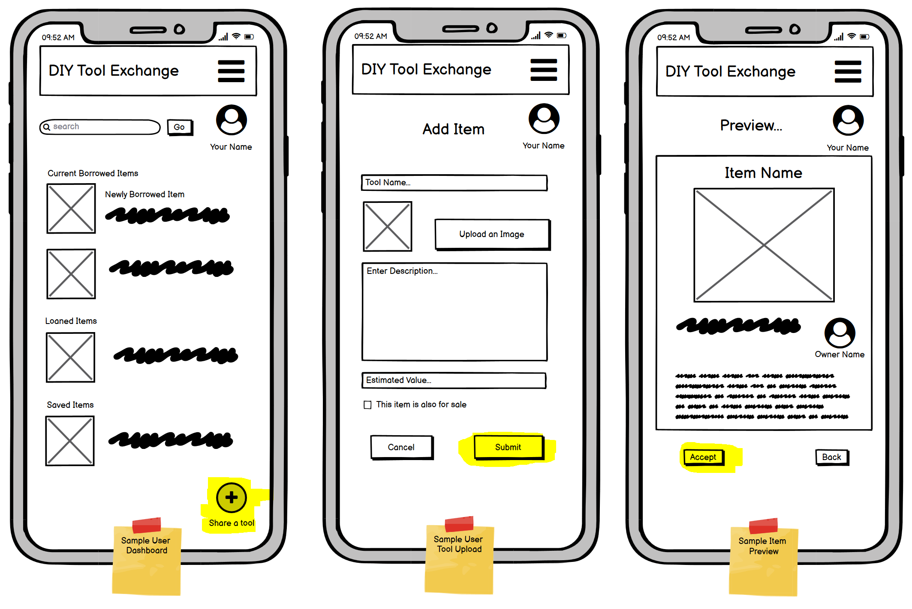
Sharing
From his dashboard, Bob clicks the Share a tool icon.
He provides the required info on the tool and selects Submit.
He is presented with a preview page which allows him to accept or go back
He selects Accept and is taken back to his dashboard.

Slide 17
Account Info
Persona: All users

Slide 18
All users have the ability to change their account info as well as view and edit their shared inventory.

Slide 19
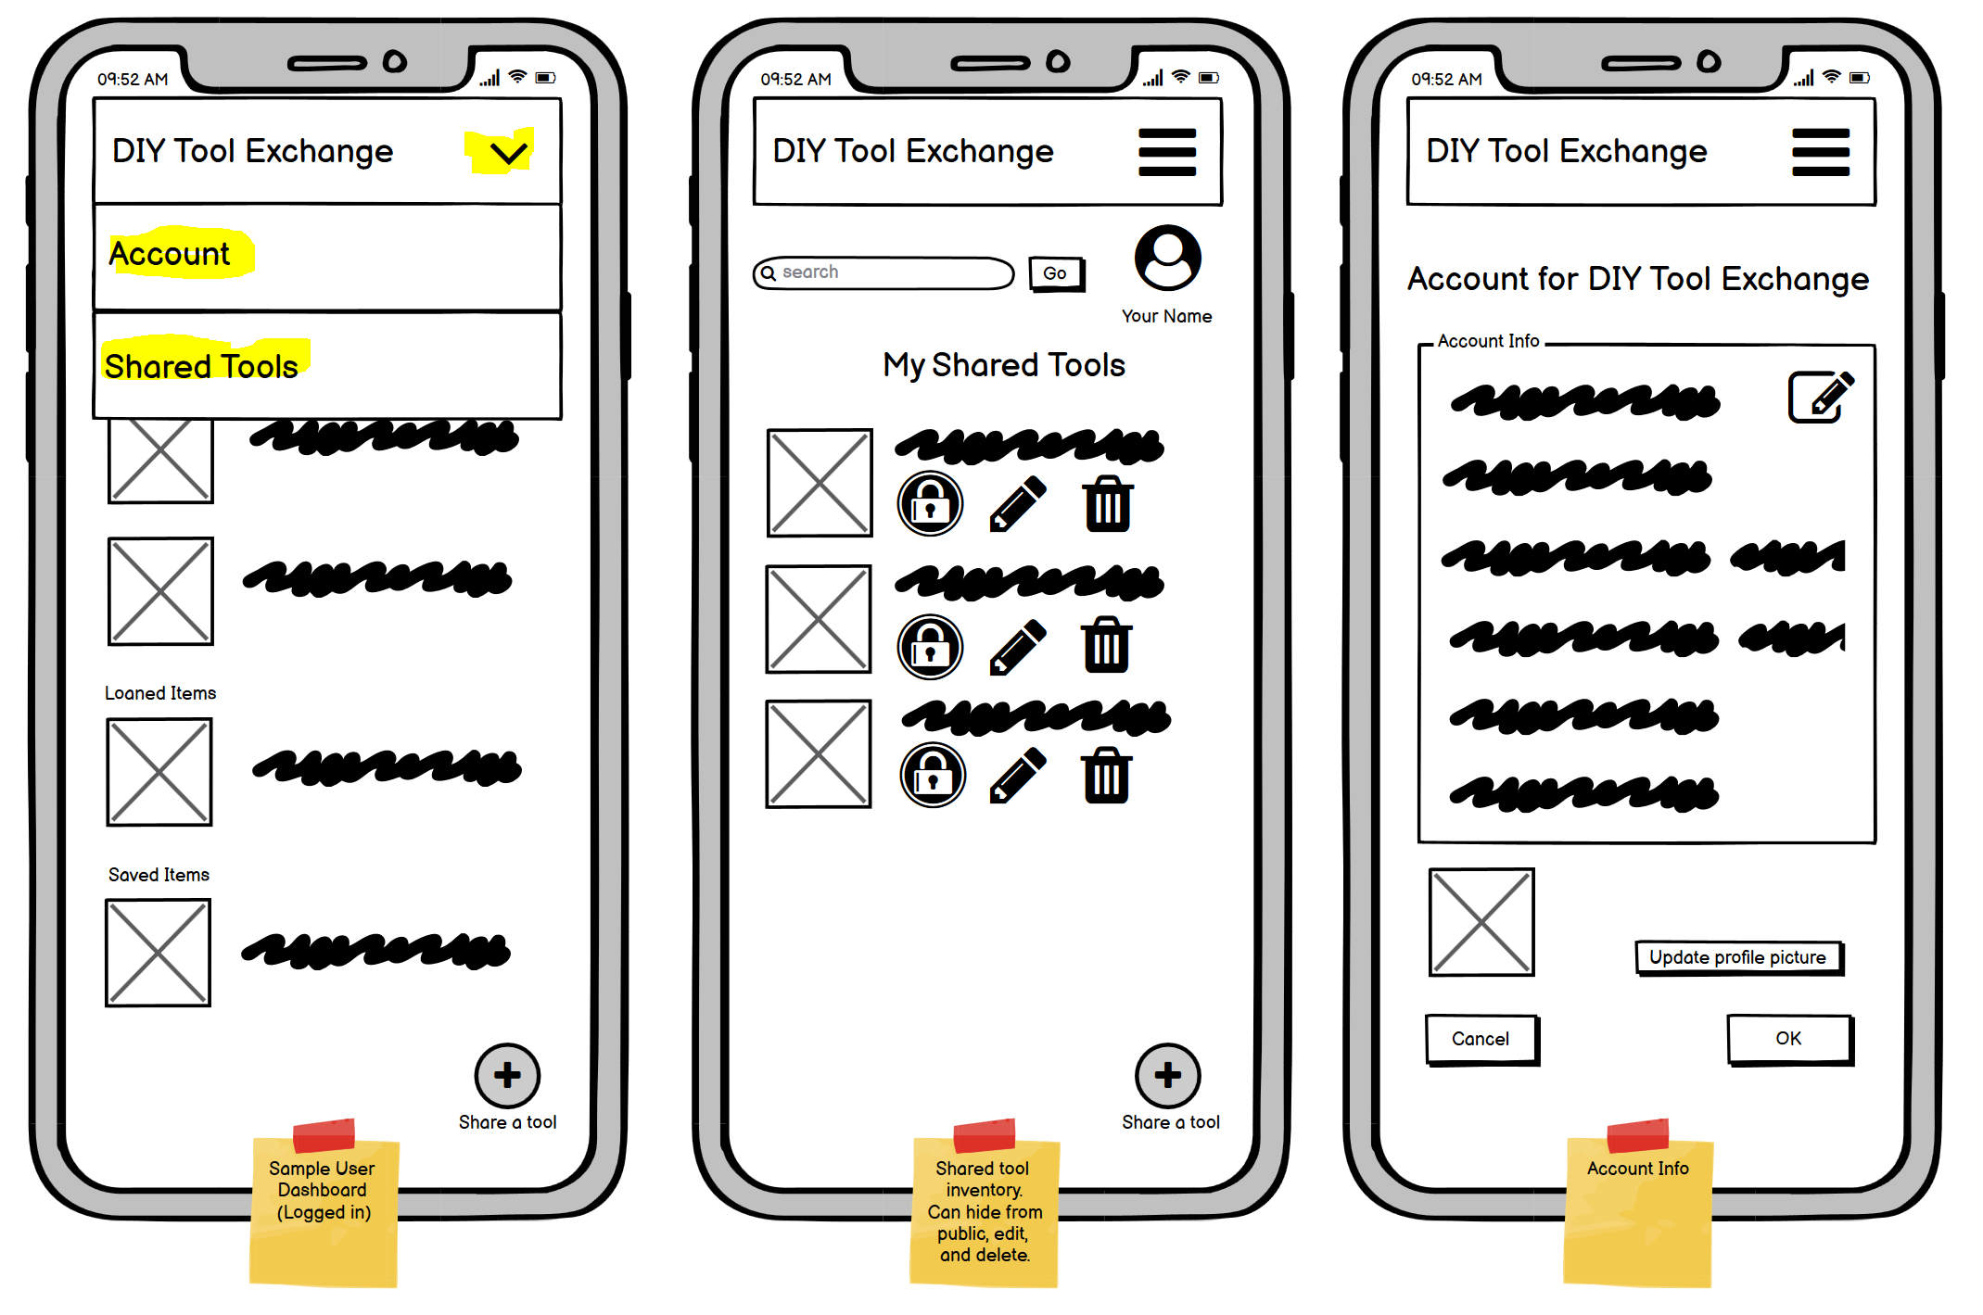
Account Info
From the dashboard, a user clicks the hamburger.
They see a dropdown menu and can select Account or Shared Tools.
From Shared tools, they can see what they are sharing, hide it, edit it, or delete it.
From Account, they can edit their account info.

Slide 20
User Review (Stretch)
Persona: Freddy Feedback

Slide 21
Freddy Feedback loaned a tool to Sue Newbie, and wants to leave Sue a rating based on the transaction.

Slide 22
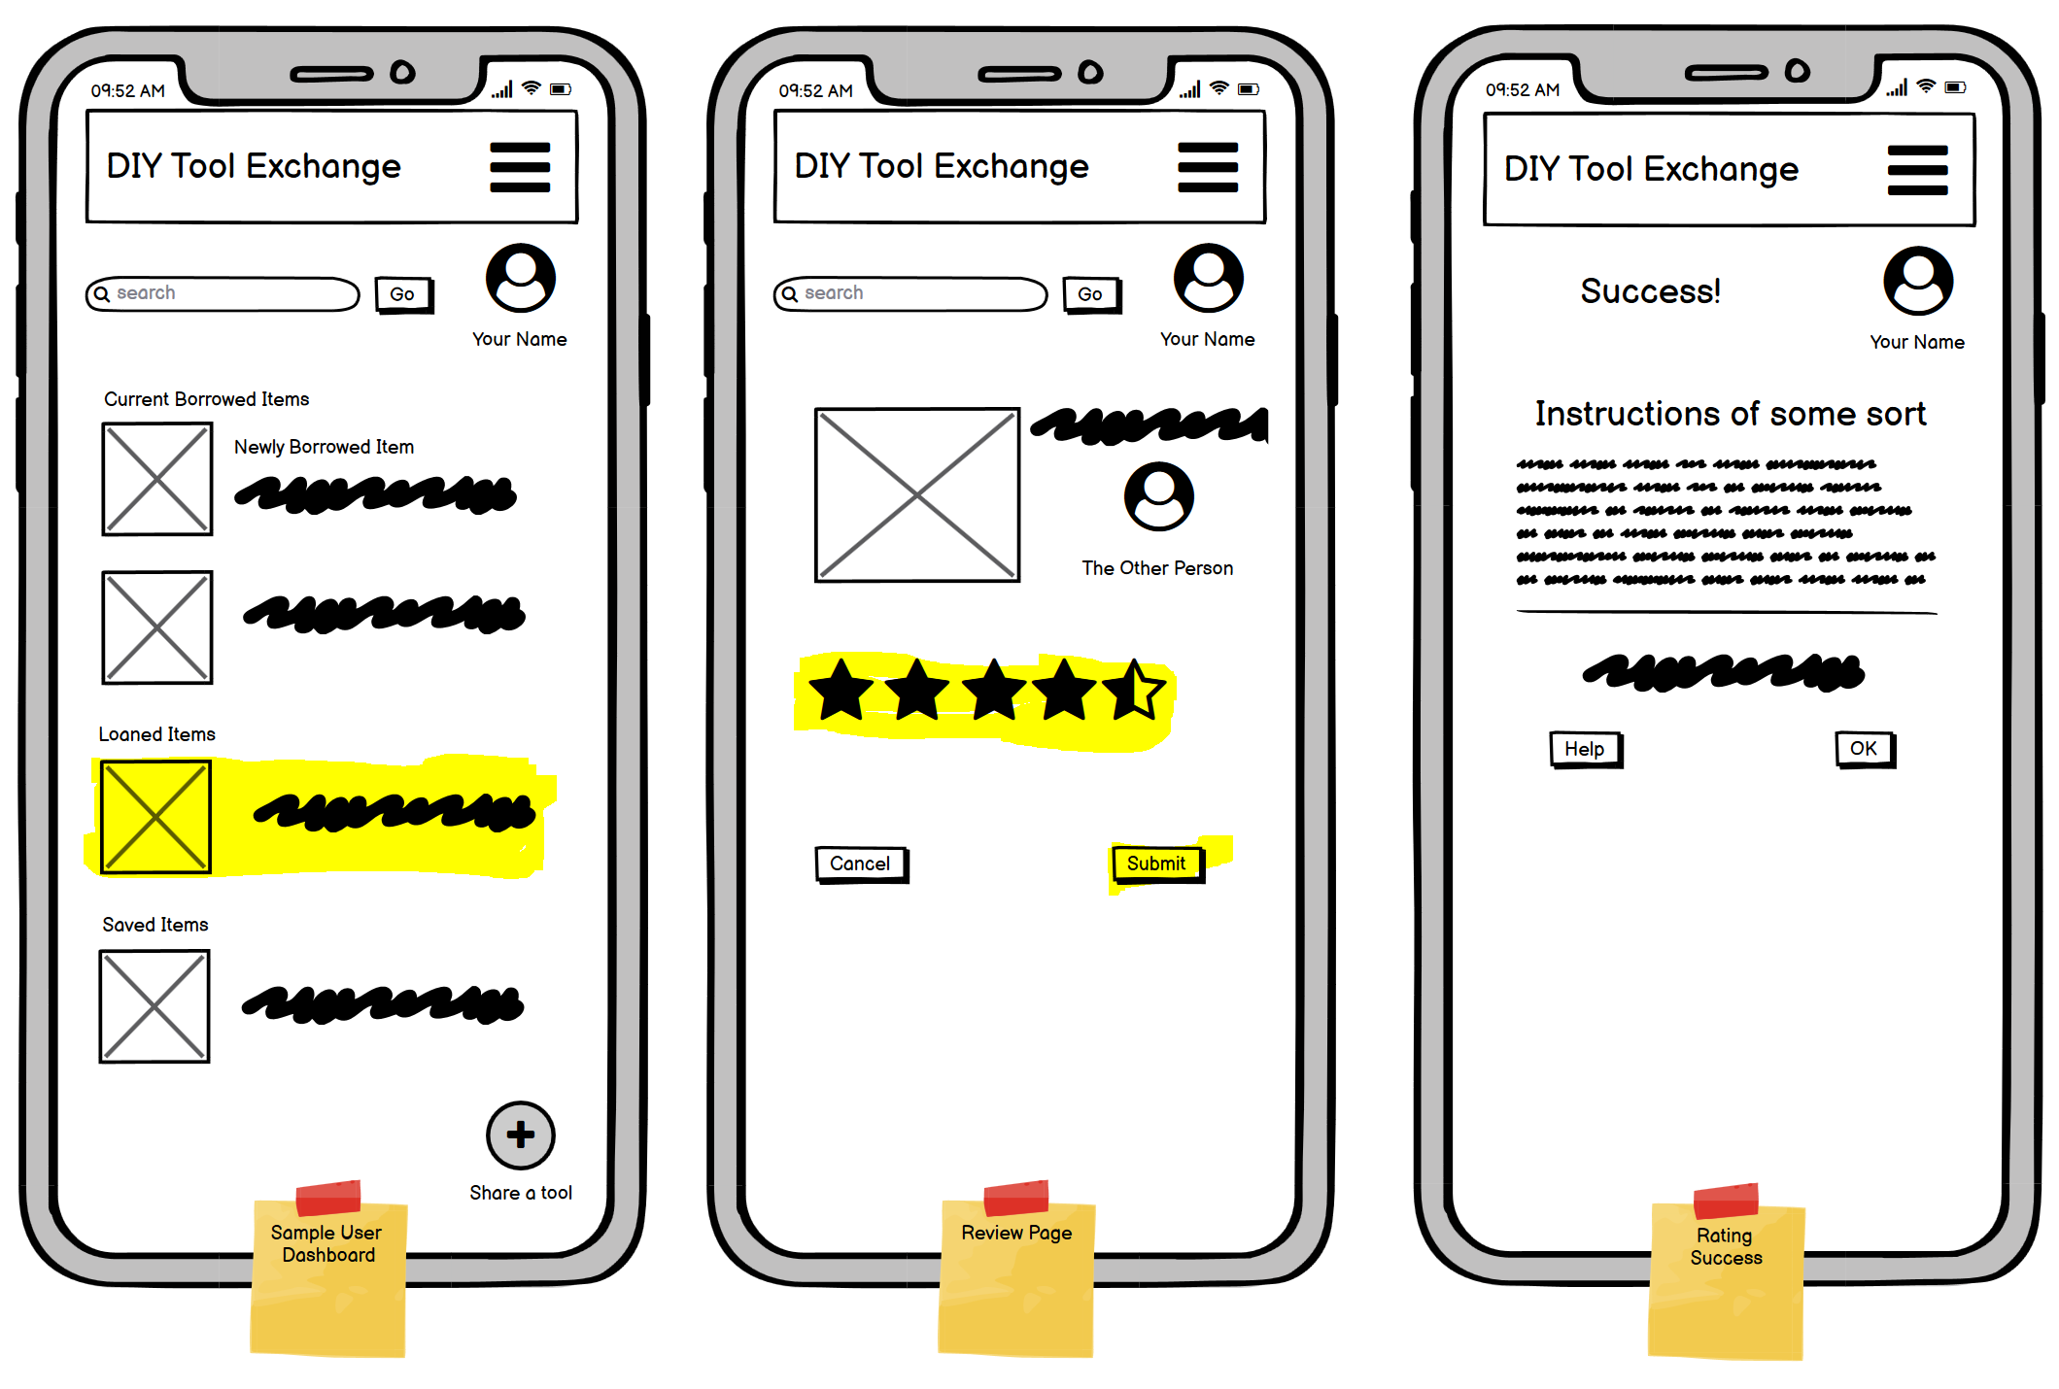
User Rating
Freddy starts on his dashboard.
He clicks on the tool he recently loaned to Sue (tool has been marked as “returned”).
He is presented with a review page.
He selects a star rating and Submits.
He is taken to a success page.

Slide 23
The End

